Slide 1
CS 478 – Tools for Machine Learning and Data Mining
Clustering: Distance-based Approaches
Notes:
Fall 2004
CS478 - Machine Learning

Slide 2
What is Clustering?
Unsupervised learning.
Seeks to organize data elements into “reasonable” groups.
Typically based on some similarity (or distance) measure defined over data elements.
Quantitative characterization may include
  Centroid / Medoid
  Radius
  Diameter
Notes:
Fall 2004
CS478 - Machine Learning

Slide 3
Clustering Taxonomy
Partitional methods:
  Algorithm produces a single partition or clustering of the data elements
Hierarchical methods:
  Algorithm produces a series of nested partitions, each of which represents a possible clustering of the data elements
Symbolic Methods:
  Algorithm produces hierarchy of concepts
Notes:
Fall 2004
CS478 - Machine Learning

Slide 4
K-means Overview
Algorithm builds a single k-subset partition
Works with numeric data only
Starts with k random centroids
Uses iterative re-assignment of data items to clusters based on some distance to centroids until all assignments remain unchanged
Notes:
Fall 2004
CS478 - Machine Learning

Slide 5
K-means Algorithm
Pick a number, k, of cluster centers (at random, do not have to be data items)
Assign every item to its nearest cluster center (e.g., using Euclidean distance)
Move each cluster center to the mean of its assigned items
Repeat steps 2 and 3 until convergence (e.g., change in cluster assignments less than a threshold)
Notes:
Fall 2004
CS478 - Machine Learning

Slide 6
K-means Demo
http://home.dei.polimi.it/matteucc/Clustering/tutorial_html/AppletKM.html
Notes:
Fall 2004
CS478 - Machine Learning

Slide 7
K-means Discussion
Result can vary significantly depending on initial choice of seeds
Can get trapped in local minimum
  Example:
  Restart with different random seeds
Does not handle outliers well
Does not scale very well
initial cluster centers
instances
Notes:
Fall 2004
CS478 - Machine Learning

Slide 8
K-means Summary
Advantages
Simple, understandable
Items automatically assigned to clusters
Disadvantages
Must pick number of clusters beforehand
All items forced into a cluster
Sensitive to outliers
Notes:
Fall 2004
CS478 - Machine Learning

Slide 9
K-medoids Overview
Also known as Partitioning Around Medoids (PAM)
Algorithm builds a single k-subset partition
Works with numeric data only
Starts with k random medoids
Uses iterative re-assignment of medoids as long as overall clustering quality improves
Notes:
Fall 2004
CS478 - Machine Learning

Slide 10
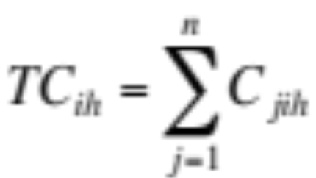
K-medoids Quality Measures
Clustering quality:
  Sum of all distances from a non-medoid object to the medoid for the cluster it is in (an item is assigned to the cluster represented by the medoid to which it is closest)
Quality impact:
  C_{jih} = cost change for item j associated with swapping medoid i for non-medoid h
  Total impact to clustering quality by medoid change (h replaces i):

Slide 11
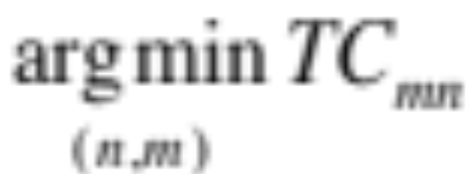
K-medoids Algorithm
Pick a number, k, of random data items as medoids
Calculate
If TC_{mn} < 0, replace m by n and go back to 2
Assign every item to its nearest medoid
The pair (n,m) of medoid/non-medoid
with the smallest impact on clustering quality
Notes:
Fall 2004
CS478 - Machine Learning

Slide 12
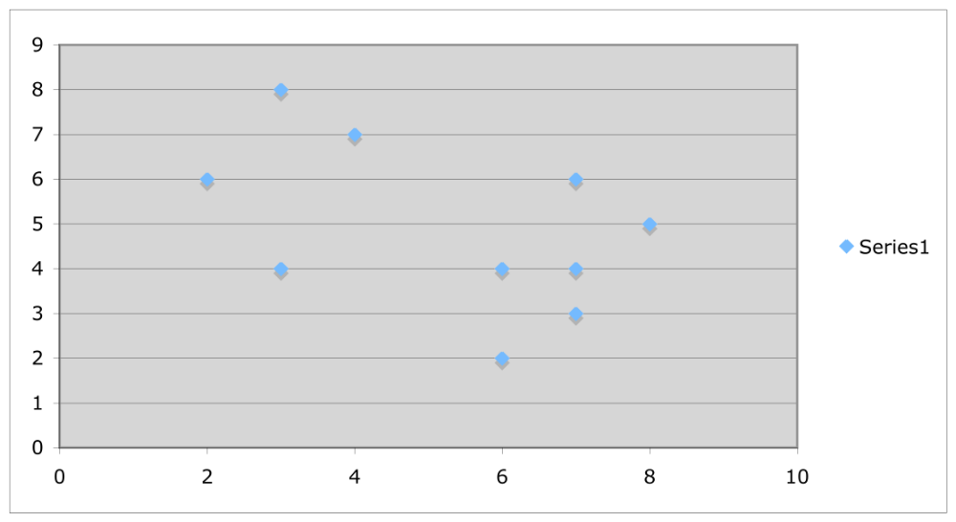
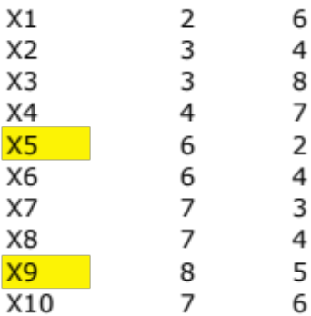
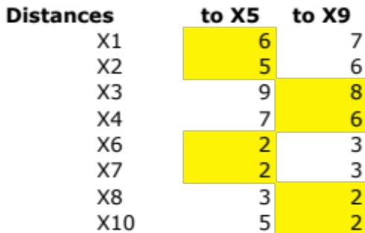
K-medoids Example (I)
Assume k=2
Select X5 and X9 as medoids
Current clustering: {X1,X2,X5,X6,X7},{X3,X4,X8,X9,X10}
Notes:
Fall 2004
CS478 - Machine Learning

Slide 13
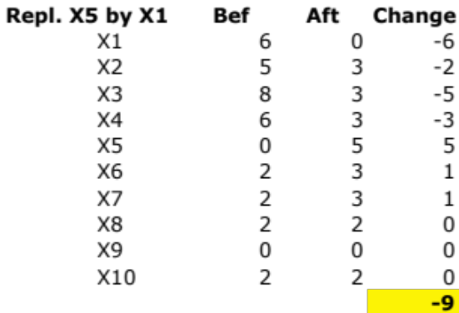
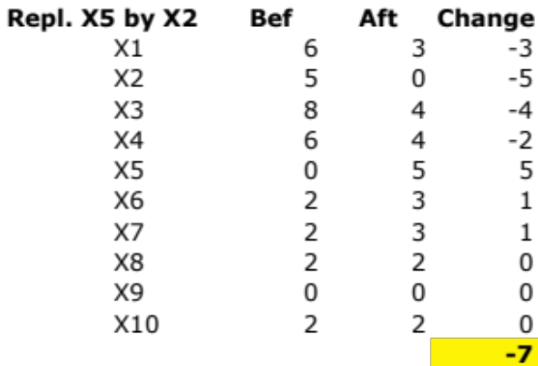
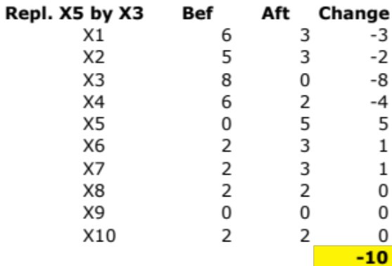
K-medoids Example (II)
Must try to replace X5 by X1, X2, X3, X4, X6, X7, X8, X10
Must try to replace X9 by X1, X2, X3, X4, X6, X7, X8, X10
Replace X5 by X4: -9
Replace X5 by X6: -5
Replace X5 by X7: 0
Replace X5 by X8: -1
Replace X5 by X10: 1
Replace X9 by X1: -7
Replace X9 by X2: -5
Replace X9 by X3: -7
Replace X9 by X4: -8
Replace X9 by X6: -3
Replace X9 by X7: 5
Replace X9 by X8: -1
Replace X9 by X10: -4
⇒ Replace X5 by X3

Slide 14
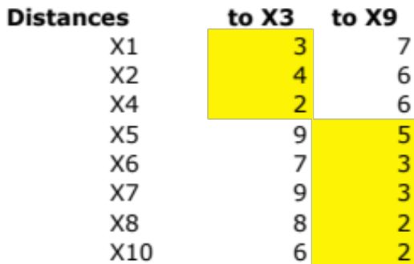
K-medoids Example (III)
X3 and X9 are new medoids
Current clustering: {X1,X2,X3,X4},{X5,X6,X7,X8,X9,X10}
No change in medoids yields better quality ⇒ DONE!
(I think)
Notes:
Fall 2004
CS478 - Machine Learning

Slide 15
K-medoids Discussion
As in K-means, user must select the value of k, but the resulting clustering is independent of the initial choice of medoids
Handles outliers well
Does not scale well
  CLARA and CLARANS improve on the time complexity of K-medoids by using sampling and neighborhoods
Notes:
Fall 2004
CS478 - Machine Learning

Slide 16
K-medoids Summary
Advantages
Simple, understandable
Items automatically assigned to clusters
Handles outliers
Disadvantages
Must pick number of clusters beforehand
High time complexity
Notes:
Fall 2004
CS478 - Machine Learning

Slide 17
Hierarchical Clustering
Focus on the agglomerative approach:
  Assign each data item to its own cluster
  Compute pairwise distances between clusters
  Merge the two closest clusters
  If more than one cluster is left, go to step 2
Notes:
Fall 2004
CS478 - Machine Learning

Slide 18
Cluster Distances
Complete-link
  Maximum pairwise distance between the items of two different clusters
Single-link
  Minimum pairwise distance between the items of two different clusters
Average-link
  Average pairwise distance between the items of two different clusters
Notes:
Fall 2004
CS478 - Machine Learning

Slide 19
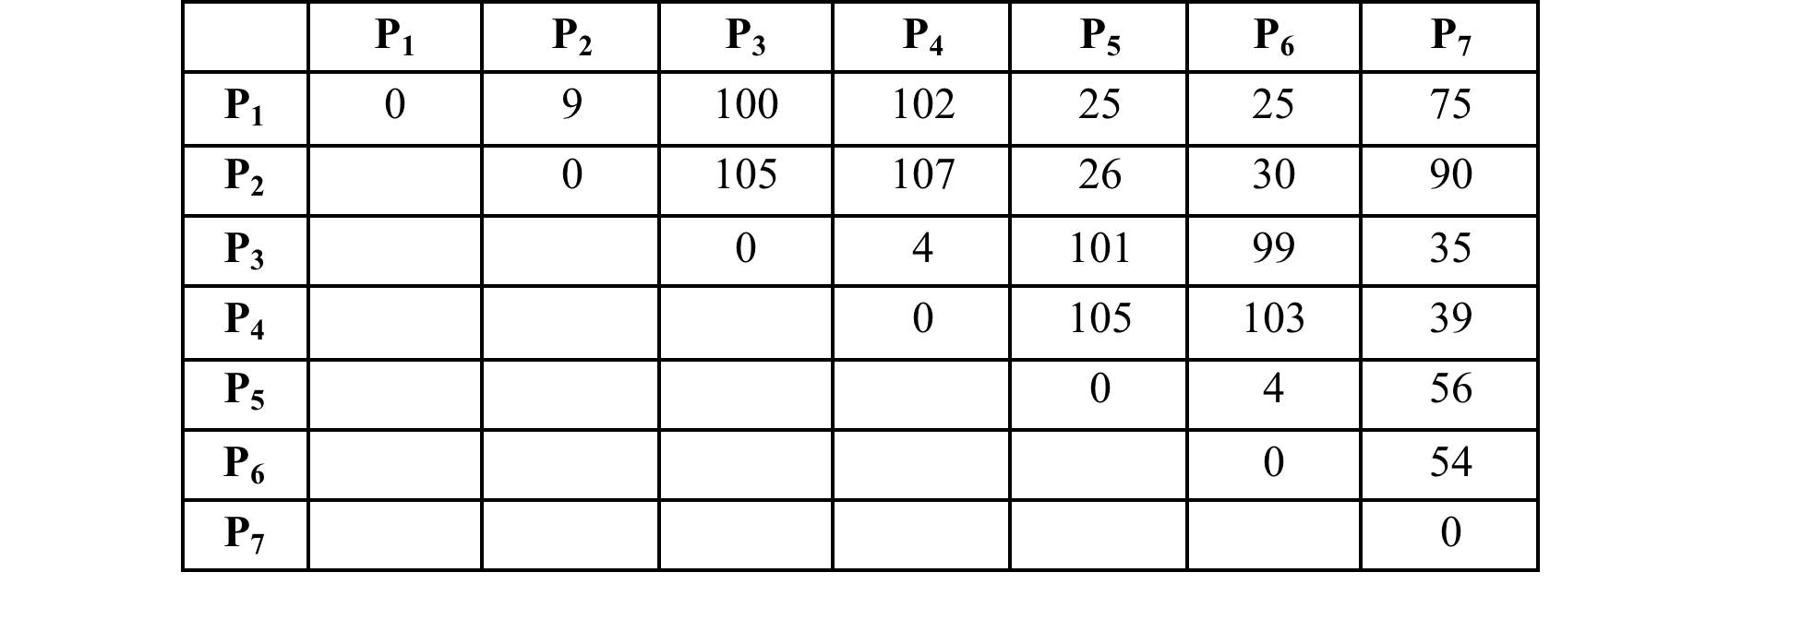
HAC Example
Assume single-link

Slide 20
HAC Demo
http://home.dei.polimi.it/matteucc/Clustering/tutorial_html/AppletH.html

Slide 21
HAC Discussion
Best implementation is O(n²logn)
No need to specify number of clusters
Still need to know when to stop:*
  Too early ⇒ clustering too fine
  Too late ⇒ clustering too coarse
  Trade one parameter (K) for another (distance threshold)?
* May also be done after the dendrogram is built

Slide 22
Picking “the” Threshold
Guessing (sub-optimal)
Looking for “jumps” in the distance function (subjective)
Human examination (expensive, unreasonable)
Semi-supervised learning
  Must-link, cannot-link constraints
  Stated explicitly or implicitly (e.g., through labels)

Slide 23
Simple Solution
Select random sample S of items
Label items in S
Cluster S
Find the threshold value T that maximizes some clustering quality measure on S
Cluster complete dataset up to T
|S|=50 was shown to give reasonable results

